Slide 1


Data Analysis
On
Social Buzz
Data

Slide 2


Today's agenda
Project recap
Problem
The Analytics team
Process
Insights
Summary

Slide 3


High-Engagement Categories: Certain content categories received significantly higher engagement, indicating strong user interest.
Sentiment Trends: The majority of user sentiments were positive, with spikes in negative sentiment often correlated with specific events or content types.
Content Type Impact: Different types of communication (e.g., visual vs. text) had varying impacts on user engagement and sentiment.
User Behaviour Patterns: Users demonstrated specific behaviours, such as peak activity times and preferred content types, which can inform future content strategies.
Project Recap

Slide 4


Problem
Data Integration and Cleaning:
Problem: The initial data was spread across multiple sheets with different formats and potentially inconsistent data points.
Solution: Merged and standardized the data from various sources to create a cohesive dataset, ensuring consistency and reliability for analysis.
Handling Missing and Inconsistent Data:
Problem: The dataset may have contained missing values, duplicates, or inconsistencies that could skew the analysis.
Solution: Conducted thorough data cleaning by identifying and addressing missing data, removing duplicates, and standardizing data formats.

Slide 5
Categorizing and Analysing Sentiment:
Problem: Sentiment analysis required categorizing user feedback and interactions into positive, negative, and neutral sentiments, which can be challenging due to the nuances of natural language.
Solution: Employed sentiment analysis techniques to accurately categorize user sentiment across different content categories, allowing for a more nuanced understanding of user emotions and reactions.
Identifying Key Engagement Metrics:
Problem: Determining which metrics (e.g., views, likes, shares, comments) were most relevant for assessing user engagement was crucial for deriving actionable insights.
Solution: Analyzed various engagement metrics to identify those most indicative of user interest and interaction, focusing on high-impact metrics to inform content strategy.

Slide 6
Understanding User Behaviour Patterns:
Problem: User behaviour on social media platforms is complex, with varying patterns of activity that can be difficult to quantify and predict.
Solution: Conducted a detailed analysis of user behaviour data to identify trends and patterns, such as peak activity times and preferred content types, which can be leveraged for more effective content planning.
Interpreting Complex Data Relationships:
Problem: The relationships between different data points (e.g., content type, sentiment, and engagement) are often non-linear and multifaceted.
Solution: Used advanced analytical techniques to explore and visualize these relationships, providing a clearer understanding of how different factors influence user engagement and sentiment.

Slide 7
Developing Data-Driven Recommendations:
Problem: Translating data insights into actionable recommendations for content strategy required a clear understanding of the implications of the findings
.
Solution: Synthesized the analysis into specific, data-driven recommendations to optimize content strategies and improve user engagement based on the identified trends and patterns.

Slide 8
SENTIMENT SCORE OF EACH CATEGORY
Category | Sentiment Score
studying | 54269
healthy eating | 69339
technology | 68738
food | 66676
cooking | 64756
dogs | 52511
soccer | 57783
public speaking | 49264
science | 71168
tennis | 50339
travel | 64880
fitness | 55323
education | 57436
veganism | 49619
animals | 74965
culture | 66579
 | 973645
Number of Unique Categories are |  |  |  | 16
Animal Category has Highest Sentiment score |  |  |  |  | 74965
Public Speaking Category has Lowest Sentiment Score |  |  |  |  | 49264

Slide 9
Content Type | Count of Content Type
audio | 570
GIF | 342
photo | 674
video | 311
Animal category is the most popular content in "Social Buzz"
Reaction Type | Count of Reaction Type
adore | 114
cherish | 125
disgust | 122
dislike | 115
hate | 128
heart | 120
indifferent | 100
interested | 110
intrigued | 116
like | 101
love | 119
peeking | 129
scared | 132
super love | 123
want | 122
worried | 121
The Scared reaction has Highest reaction type for Animal Category 132

Slide 10
Monthly Post Activity in Social buzz
Most of the Posts were posted in the form of Photos 6589
Content Type | Count
photo | 6589
video | 6245
GIF | 6079
audio | 5660
Month | Posts
1 | 2034
2 | 2021
3 | 1974
4 | 2126
5 | 2114
6 | 2092
7 | 1974
8 | 2126
9 | 1974
10 | 2114
11 | 2034
12 | 2034
Total | 24617

Slide 11
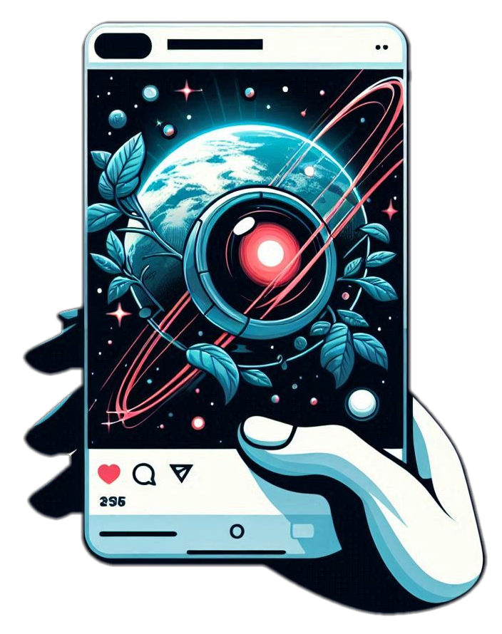

SENTIMENT TYPE FOR EACH CATEGORY
RESULT
 |  | Category
maximun positive Sentiment | 1050 | animals
minimum positive Sentiment | 689 | veganism
maximum negative Sentiment | 618 | animals
minimum negative Sentiment | 363 | public speaking
maximum neutral Sentiment | 234 | science
minimum neutral Sentiment | 142 | public speaking
Category | Postive | Negative | Neutral
studying | 768 | 425 | 170
healthy eating | 985 | 520 | 212
technology | 974 | 510 | 214
food | 943 | 544 | 212
cooking | 932 | 550 | 182
dogs | 744 | 409 | 185
soccer | 817 | 440 | 200
public speaking | 712 | 363 | 142
science | 1015 | 547 | 234
tennis | 716 | 450 | 162
travel | 918 | 533 | 196
fitness | 786 | 441 | 168
education | 815 | 430 | 188
veganism | 689 | 392 | 167
animals | 1050 | 618 | 229
culture | 943 | 523 | 210
Total | 13807 | 7695 | 3071

Slide 12


REACTION TYPE FOR EACH CATEGORY
Animal Category has the Highest sentiment score 74965
Category | adore | cherish | disgust | dislike | hate | heart | indifferent | interested | intrigued | like | love | peeking | scared | super love | want | worried
studying | 89 | 92 | 77 | 74 | 85 | 101 | 77 | 87 | 84 | 80 | 83 | 93 | 95 | 86 | 66 | 93
healthy eating | 122 | 105 | 103 | 101 | 121 | 114 | 108 | 101 | 107 | 106 | 103 | 104 | 100 | 116 | 111 | 95
technology | 129 | 114 | 110 | 95 | 112 | 114 | 98 | 121 | 87 | 87 | 96 | 116 | 88 | 113 | 113 | 105
food | 93 | 119 | 107 | 106 | 130 | 107 | 97 | 108 | 94 | 100 | 123 | 115 | 101 | 89 | 110 | 100
cooking | 106 | 84 | 109 | 115 | 104 | 112 | 81 | 125 | 88 | 114 | 99 | 101 | 120 | 110 | 94 | 102
dogs | 81 | 72 | 87 | 84 | 87 | 97 | 93 | 91 | 70 | 93 | 73 | 92 | 89 | 84 | 83 | 62
soccer | 87 | 86 | 91 | 81 | 87 | 93 | 116 | 88 | 93 | 91 | 87 | 84 | 99 | 95 | 97 | 82
public speaking | 76 | 65 | 69 | 82 | 61 | 88 | 77 | 75 | 92 | 74 | 85 | 65 | 75 | 76 | 81 | 76
science | 118 | 103 | 114 | 113 | 102 | 115 | 122 | 118 | 111 | 113 | 119 | 112 | 102 | 92 | 126 | 116
tennis | 73 | 81 | 94 | 92 | 87 | 90 | 86 | 87 | 82 | 80 | 77 | 76 | 88 | 73 | 73 | 89
travel | 115 | 99 | 111 | 122 | 95 | 105 | 97 | 90 | 104 | 111 | 94 | 99 | 105 | 91 | 109 | 100
fitness | 96 | 73 | 96 | 95 | 71 | 83 | 82 | 81 | 82 | 111 | 88 | 86 | 96 | 100 | 72 | 83
education | 83 | 87 | 73 | 91 | 96 | 91 | 89 | 88 | 96 | 90 | 105 | 99 | 80 | 92 | 83 | 90
veganism | 71 | 83 | 65 | 70 | 91 | 95 | 78 | 69 | 68 | 72 | 75 | 89 | 85 | 79 | 77 | 81
animals | 114 | 125 | 122 | 115 | 128 | 120 | 100 | 110 | 116 | 101 | 119 | 129 | 132 | 123 | 122 | 121
culture | 95 | 113 | 98 | 112 | 94 | 97 | 111 | 110 | 101 | 97 | 108 | 99 | 117 | 100 | 122 | 102
Totals | 1548 | 1501 | 1526 | 1548 | 1551 | 1622 | 1512 | 1549 | 1475 | 1520 | 1534 | 1559 | 1572 | 1519 | 1539 | 1497

Slide 13



USER BEHAVIOUR
Hours | Count
0 | 1029
1 | 1017
2 | 975
3 | 1024
4 | 1011
5 | 1038
6 | 1087
7 | 1044
8 | 1060
9 | 1075
10 | 1001
11 | 1026
12 | 960
13 | 1013
14 | 1001
15 | 1021
16 | 1044
17 | 988
18 | 1013
19 | 1010
20 | 1024
21 | 1019
22 | 1021
23 | 1072

Slide 14
RATE OF SENTIMENT
Social Media Buzz:
 | Positive Sentiment: 54% Neutral Sentiment: 14% Negative Sentiment: 32%
This breakdown shows that the majority of the buzz around the social media platform is positive, with over half of the mentions reflecting a favourable view. However, there is still a significant portion of negative sentiment at 32%, indicating some areas of concern or dissatisfaction. The remaining 14% of mentions are neutral, suggesting a balanced or indifferent perspective.

Slide 15
GROWTH OF USERS PER YEAR
Hour | Count
0 | 24
1 | 19
2 | 20
3 | 17
4 | 20
5 | 16
6 | 17
7 | 17
8 | 19
9 | 25
10 | 19
11 | 21
12 | 24
13 | 29
14 | 16
15 | 22
16 | 28
17 | 18
18 | 24
19 | 28
20 | 12
21 | 22
22 | 24
23 | 19
24 | 0
Year | Users
2020 | 500
2021 | 496
rate of increase in user's in Social buzz is Comparatively low
Most of the user's Spent time in the social buzz at 13:00 pm

Slide 16
CONTENT TYPE
Type2 | User Count
photo | 797
audio | 792
GIF | 790
video | 787
Most customers utilize a variety of chat categories, including live chat, chat bots, web chat to text, and social media support, to meet their diverse needs. Leveraging these options ensures comprehensive and effective customer service.
All of the customers are using all type of Communication Categories equally in Conversation to a post or Comment.

Slide 17



Analysing Social Buzz: A Collaborative Data Insight Project with Andrew Fleming, Marcus Rompton, and Vinay raj

Slide 18

Merged Data: A comprehensive dataset combining various data points across different categories and user interactions to provide a unified view of social media activity.
Process
1
Category Score and Categorical Views: Analysed scores assigned to different content categories based on engagement metrics and user feedback, along with the number of views or interactions received by each content type.
2
Communication Type Analysis: Examined different types of communications (such as posts, comments, and shares) to understand their impact on user engagement and sentiment.
3
Sentiment Analysis: Conducted a breakdown of sentiments (positive, negative, neutral) across various categories and analysed the rate of these sentiments over time.
4
User Behaviour Insights: Identified user behaviour patterns, including engagement levels, activity frequency, and interaction types, to understand how users interact with content on the platform.
5

Slide 19


Insights
Sentiment Trends: Negative sentiment is higher in categories like customer service, indicating areas for improvement to boost customer satisfaction.
Top Content Categories: Categories such as technology and lifestyle have the highest engagement, guiding future content focus.
Effective Communication: Interactive and personalized posts drive more engagement than generic ones, suggesting a shift in strategy.
User Behaviour Changes: Increased interest in video and interactive content highlights a need to adapt content formats.
Sentiment and Engagement: Positive sentiment correlates with higher engagement, emphasizing the need to manage negative feedback effectively.

Slide 20


Sentiment and Engagement: The analysis shows that positive sentiment correlates with higher engagement, while negative sentiment, particularly in customer service categories, indicates areas needing improvement.
Content and Communication Strategies: High engagement is seen in technology and lifestyle content, and interactive, personalized communication methods are more effective than generic ones, suggesting a focus on these areas for future strategies.
User Behaviour Trends: There is a growing preference for video and interactive content, signaling a need to adapt content formats to meet evolving user preferences and maximize engagement.
Summary

Slide 21

Thank you!
ANY QUESTIONS?

